Slide 1
The Longest Day of “Why?”
Psalm 22, John 11, Matthew 27:22-61

Slide 2

“The Longest Day” was a movie about June 6, 1944. It was made released in 1962, and had nearly every famous actor available that year: John Wayne, Henry Fonda, Richard Burton, Robert Mitchum, Sean Connery, Eddie Albert, Peter Lawford, Mel Ferrer, George Segal, Roddy McDowall, and the list goes on and on.

Slide 3
It told the story of D-Day, when the Allies invaded the beaches in Normandy, France to defeat Germany in WWII. It definitely was a very long day.

Slide 4
But, other days have seemed long as well.
Bad news came
Diagnosis at the doctor
Relationship loss
Job
Storms, real or figurative

Slide 5
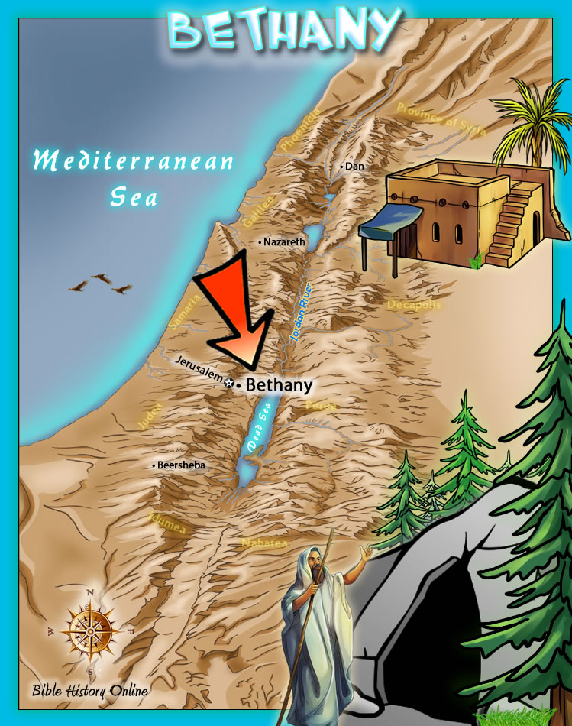
John 11:1-44

Slide 6
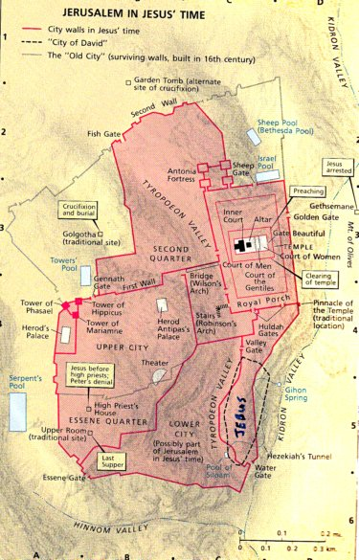
What we call “Good Friday” didn’t seem good at the time…

